Slide 1
AZ-220T01 Module 09: Solution testing, diagnostics, and logging

Slide 2
Lesson 1: Learning objectives

Slide 3
Module 9 – Learning objectives
Describe the options for monitoring and logging an Azure IoT solution
Configure Azure Monitor to support of an IoT solution
Configure IoT Hub Metrics to support of an IoT solution
Implement diagnostics logging
Troubleshoot IoT device connection and communication issues

Slide 4
Lesson 2: Monitoring and logging

Slide 5


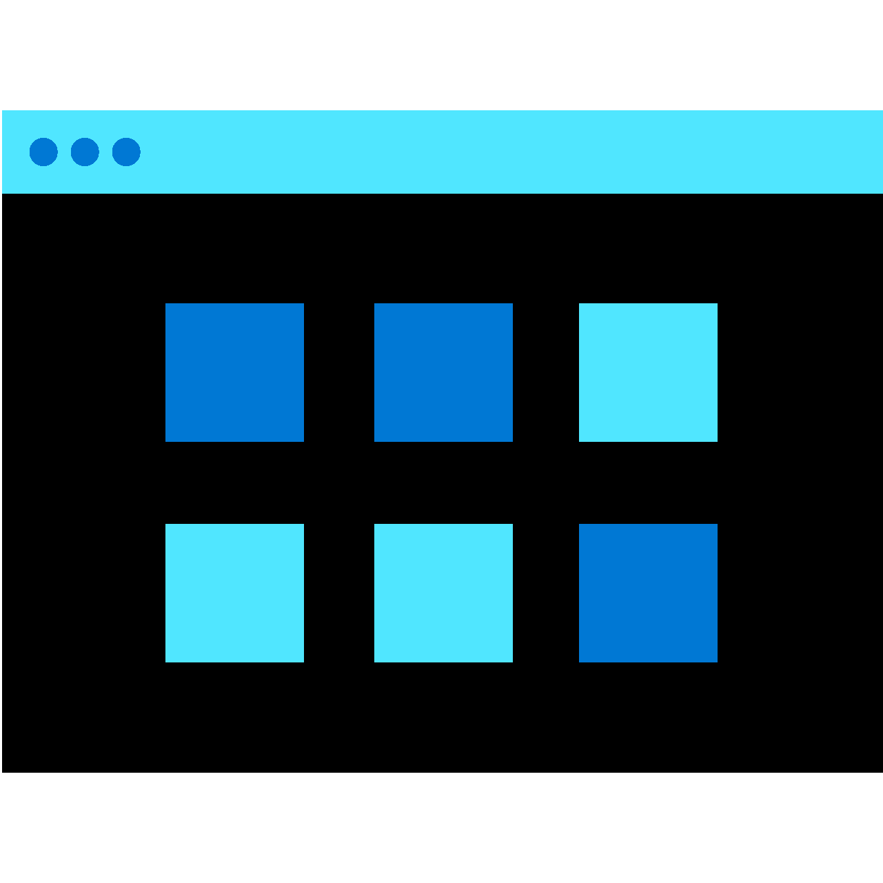


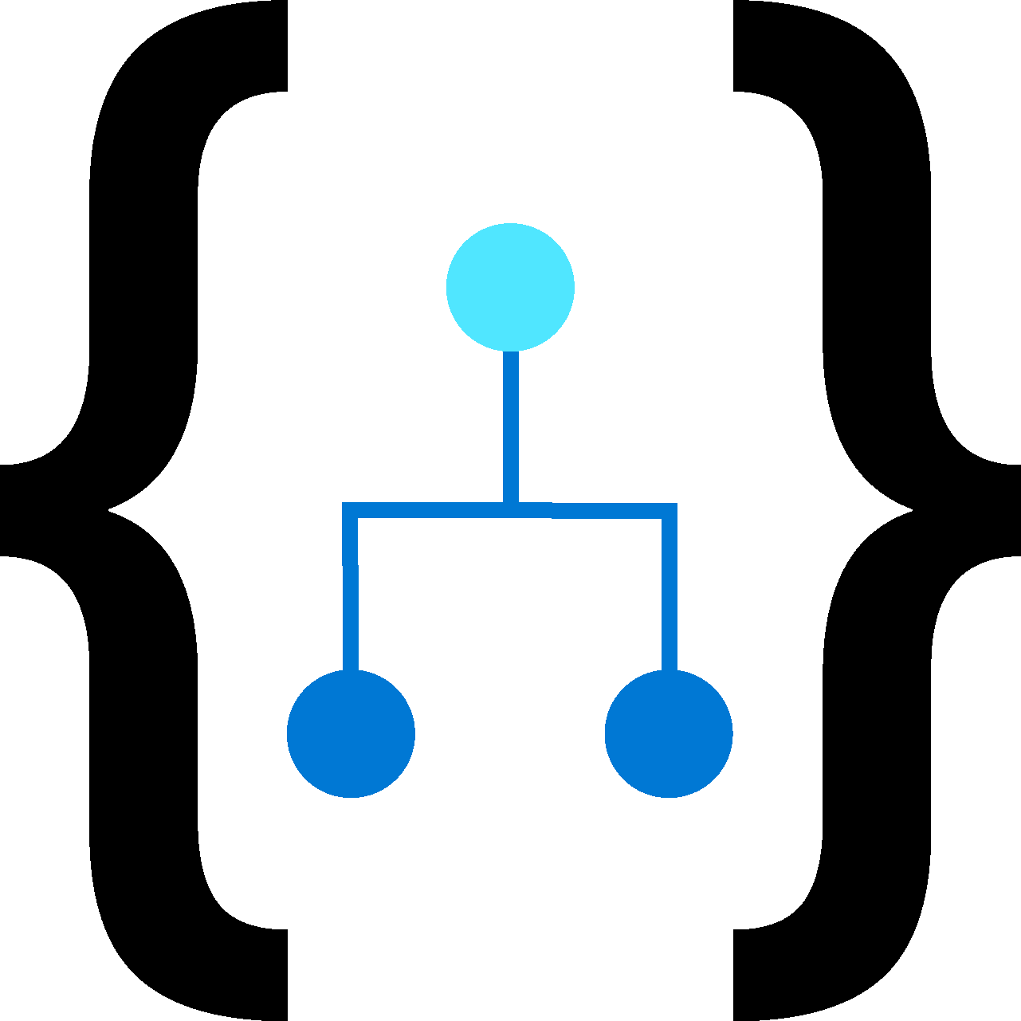

Azure Monitor
Azure Monitor
Insights
Application
Application
Container
VM
Monitoring Solutions
Operating System
Metrics
Visualize
Dashboard
Views
Power BI
Workbook
Azure Resources
Analyze
Azure Subscription
Logs
Metric Analytics
Log Analytics
Azure Tenant
Respond
Custom Sources
Alerts
Auto scale
Integrate
Logic Apps
Export APIs
Notes:
This is an overview of the design of Azure Monitor. This is a good time to describe the differences between metrics and logs. We deep-dive on those concepts in later slides.

Slide 6
Azure Monitor alerts
Alert Rule
Target Resource
Signal
Criteria/Logic Test
Action Group
Monitor Condition
Actions to do
Alert State
Notes:
This is something readily demoed – for example, you can have a VM with an activity log alert on start that calls you on your cell phone, and answer the call on speaker.

Slide 7
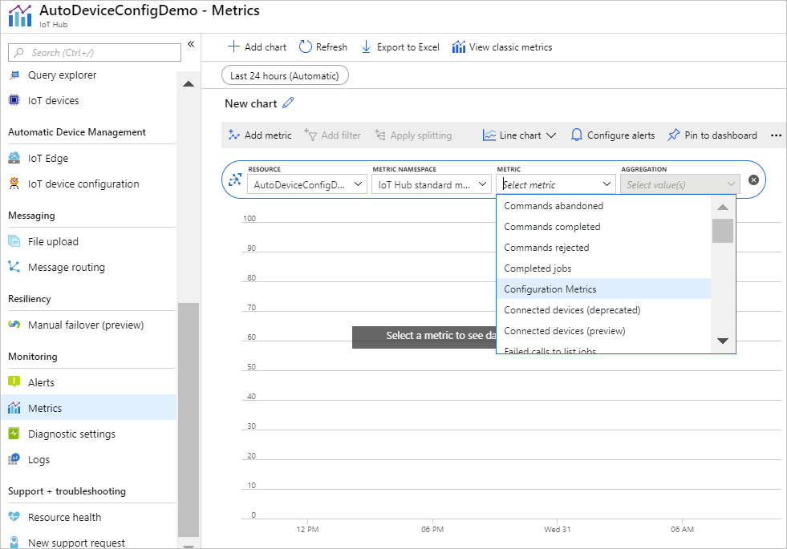
IoT Hub metrics
Notes:
“We said that Azure Monitor collects metrics and logs. Let’s talk about the metrics first…”
The purpose of this slide is to show where the student can quickly access metrics in the IoT Hub interface. You absolutely should consider demoing this. The SkillPipe goes into more detail, but you don’t want to do that in the presentation.
The lab uses the following metrics, FYI:
Telemetry messages sent
Connected devices (preview)

Slide 8
Diagnostics tools
Use Azure Monitor:
Understand the logs
Read logs from Azure Event Hubs
Use Azure Resource Health
Notes:
“Now that we have looked at the metrics side, let’s look at the logs side. Like everything in Azure, IoT Hub sends logs to Azure Monitor, where you can collect them and send them along.”
Don’t spend a lot of time on this slide – the next slides are a pseudo-build slide that goes into detail.

Slide 9
Diagnostics tools
Use Azure Monitor:
Understand the logs
Read logs from Azure Event Hubs
Use Azure Resource Health
Notes:
“But what are some samples of logs that are sent in?”
The SkillPipe again has details here so you can point them at that. The lab does enable diagnostics logging so the students will see that in person there.
This is when you should talk about where logs can be sent to for long-term storage or for analysis – the SkillPipe lists:
Archive to a storage account
Stream to an event hub
Send to Log Analytics
You should mention these but not necessarily in that exact order, because the flow to the next slide might be better if event hubs are named last.

Slide 10
Diagnostics tools
Use Azure Monitor:
Understand the logs
Read logs from Azure Event Hubs
Use Azure Resource Health
Notes:
This topic is meant to explain that because you can send logs to an event hub, that’s an easy way to consume them in another monitoring solution or connector. There’s sample code in the SkillPipe for this.

Slide 11
Diagnostics tools
Use Azure Monitor:
Understand the logs
Read logs from Azure Event Hubs
Use Azure Resource Health
Notes:
Here, you’ll want to explain how Resource Health lets them see if their IoT Hub is working at all, from a back-end Azure service viewpoint.

Slide 12
Device connection state and lifecycle notifications
Heartbeat Pattern – regularly timed device-to-cloud messages validating working connectivity
Device and Module Lifecycle Notifications – used for information on device and module identity creation and deletion:
Not seen by default
To see them, create a route and to set the Data Source equal to DeviceLifecycleEvents or ModuleLifecycleEvents
Notes:
The logic in this slide and content at this point is that we have covered the generic concepts of monitoring and diagnostics, and now we’re getting more specific.
https://docs.microsoft.com/en-us/azure/iot-hub/iot-hub-devguide-identity-registry#device-heartbeat

Slide 13
Quotas and throttling
Operation throttles:
Throttling limits:
Throttling is the same for all tiers
Limits are based on the edition within the tier and the number of units
Traffic shaping:
You can exceed the throttling limit for a short time
After that, requests will be queued
If too many requests are queued, messages start failing with a 429 error
Identity registry operations throttling exists because there are import and export capabilities for bulk at-once provisioning
Device connections throttling is around creation of a new connection, not around number of existing connections
Other limits
Notes:
https://docs.microsoft.com/en-us/azure/iot-hub/iot-hub-devguide-quotas-throttling
Each IoT hub is provisioned with a certain number of units in a specific tier. The tier and number of units determine the maximum daily quota of messages that you can send. The message size used to calculate the daily quota is 0.5 KB for a free tier hub and 4KB for all other tiers.
The tier also determines the throttling limits that IoT Hub enforces on all operations.
As a small, fun thing, if students don’t know the 429 error, you can show them https://http.cat/429 .
We haven’t talked about bulk import/export until now - https://docs.microsoft.com/en-us/azure/iot-hub/iot-hub-bulk-identity-mgmt.
For “other limits,” this is things like 1_000_000 devices per hub The SkillPipe has details but they aren’t important to us here.

Slide 14
Lesson 3: Troubleshooting

Slide 15
Connection and retry patterns
Error patterns – the device SDKs process three categories of errors
Retry patterns – the device SDKs have three retry policies
1
Network errors – Disconnected sockets, name resolution errors
1
Exponential back-off with jitter
2
Protocol-level errors – Detached links, expired sessions
2
Custom retry policy (not in the C SDK)
3
Application-level errors – Invalid credentials, service throttling
3
No retry
Notes:
https://docs.microsoft.com/en-us/azure/iot-hub/iot-hub-reliability-features-in-sdks
Notice the error patterns don’t mention OS errors and hardware errors – the device SDKs don’t handle those.
Retry patterns
The following steps describe the retry process when connection errors are detected:
The SDK detects the error and the associated error in the network, protocol, or application.
The SDK uses the error filter to determine the error type and decide if a retry is needed.
If the SDK identifies an unrecoverable error, operations like connection, send, and receive are stopped. The SDK notifies the user. Examples of unrecoverable errors include an authentication error and a bad endpoint error.
If the SDK identifies a recoverable error, it retries according to the specified retry policy until the defined timeout elapses. Note that the SDK uses Exponential back-off with jitter retry policy by default.
When the defined timeout expires, the SDK stops trying to connect or send. It notifies the user.
The SDK allows the user to attach a callback to receive connection status changes.
The SDKs provide three retry policies:
Exponential back-off with jitter: This default retry policy tends to be aggressive at the start and slow down over time until it reaches a maximum delay. The design is based on Retry guidance from Azure Architecture Center.
Custom retry: For some SDK languages, you can design a custom retry policy that is better suited for your scenario and then inject it into the RetryPolicy. Custom retry isn't available on the C SDK, and it is not currently supported on the Python SDK. The Python SDK reconnects as-needed.
No retry: You can set retry policy to "no retry," which disables the retry logic. The SDK tries to connect once and send a message once, assuming the connection is established. This policy is typically used in scenarios with bandwidth or cost concerns. If you choose this option, messages that fail to send are lost and can't be recovered.

Slide 16
Troubleshooting guide for D2C communication issues
Cannot connect to your Azure IoT hub
Not detecting disconnections
Failing to send some messages
Notes:
https://docs.microsoft.com/en-us/azure/iot-hub/iot-hub-troubleshoot-connectivity
Cannot connect to your Azure IoT Hub? Check for:
Credentials
Device registered and enabled
Firewalling and network
Code error
Not detecting disconnections? Investigate:
Retry logic
Detailed logs
Failing to send some messages? Consider:
How do you know?
Detection logic will lead to investigation logic
Don’t deep dive on the bulleted items listed here in the notes – refer them to the courseware. It’s just meant to set a high-level mindset on what kinds of issues a developer might be called in to help troubleshoot.

Slide 17
Lesson 4: Module labs

Slide 18
Module 9 labs
Lab 17: How to manage your Azure IoT hub
You will enable diagnostic logs and metrics
You will set up alerts for your metrics
You will download and run an app that simulates IoT devices connecting via X.509 and sending messages to the hub
You will run the app until the alerts begin to fire, and then observe the metrics and check the diagnostic logs

Slide 19
Lesson 5: Module 9 review questions

Slide 20
Module review: Question 9.1
You are developing an IoT solution for your company. You have IoT devices and IoT Edge devices configured and running in your solution. You think that your solution is working great and you want to keep it that way. You decide to investigate tools that can be used for monitoring and logging
What does Azure Monitor do to help you manage your IoT solution? (choose one best answer)
Answer A:
It monitors your devices
Answer B:
It monitors your device telemetry
Answer C:
It monitors your IoT Hub
Answer D:
It monitors your Edge modules
Notes:
Correct Answer: C
Explanation: In the student workbook/skillpipe content, topic Azure Monitor - Alerts and Log Analytics includes the following:
The Azure IoT Hub service uses Azure Monitor to provide support for Alerts and Log Analytics.
Azure Monitor maximizes the availability and performance of your applications and services by delivering a comprehensive solution for collecting, analyzing, and acting on telemetry from your cloud and on-premises environments. It helps you understand how your applications are performing and proactively identifies issues affecting them and the resources they depend on.

Slide 21
Module review: Question 9.2
You are developing an IoT solution for your company. You have IoT devices and IoT Edge devices configured and running in your solution. You think that your solution is working great and you want to keep it that way. You are looking into tools that can be used for monitoring and logging
Which of the following statements about IoT Hub Metrics are correct? (choose all correct answers)
Answer A:
IoT Hub metrics enable you to assess the overall health of the IoT Hub service
Answer B:
IoT Hub metrics enable you to assess the overall health of the devices connected to your IoT Hub
Answer C:
Metrics are enabled by default
Answer D:
Metrics are disabled by default
Notes:
Correct Answer: A, B, C
Explanation: In the student workbook/skillpipe content, topic IoT Hub Metrics includes the following:
IoT Hub Metrics
IoT Hub metrics provide you with access to data that describes the state of the Azure IoT resources in your Azure subscription. IoT Hub metrics enable you to assess the overall health of the IoT Hub service and the devices connected to it. User-facing statistics are important because they help you see what is going on with your IoT hub and help root-cause issues without needing to contact Azure support.
Metrics are enabled by default.
IoT Hub Metrics and How to Use Them
IoT Hub provides metrics that give you an overview of the health of your hub and the total number of connected devices, as well as metrics that give you specific details related to key operations. You can combine information from multiple metrics to paint a bigger picture of the state of the IoT hub.

Slide 22
Module review: Question 9.3
You are developing an IoT solution for your company. You have IoT devices and IoT Edge devices configured and running in your solution. You think that your solution is working great and you want to keep it that way. You have begun implementing monitoring and logging tools. You want to track the total number of connected devices and the percentage of deployed devices that are connected at any given time
What is the correct way to check the connected/disconnected state of a device? (choose one best answer)
Answer A:
Query the connection State field of the IoT Hub identity registry
Answer B:
Maintain a record of the last message received from each device
Answer C:
Configure a direct method on the device that can be used for testing connection state
Answer D:
Use device twin desired and reported properties that can be used for testing connection state
Notes:
Correct Answer: B
Explanation: In the student workbook/skillpipe content, topic Device Connection State and Lifecycle Notifications includes the following:
Device heartbeat
The IoT Hub identity registry contains a field called connectionState. Only use the connectionState field during development and debugging. IoT solutions should not query the field at run time. For example, do not query the connectionState field to check if a device is connected before you send a cloud-to-device message or an SMS. We recommend subscribing to the device disconnected event on Event Grid to get alerts and monitor the device connection state.
If your IoT solution needs to know if a device is connected, you can implement the “heartbeat pattern”. In the heartbeat pattern, the device sends device-to-cloud messages at least once every fixed amount of time (for example, at least once every hour). Therefore, even if a device does not have any data to send, it still sends an empty device-to-cloud message (usually with a property that identifies it as a heartbeat). On the service side, the solution maintains a map with the last heartbeat received for each device. If the solution does not receive a heartbeat message within the expected time from the device, it assumes that there is a problem with the device.
A more complex implementation could include the information from Azure Monitor and Azure Resource Health to identify devices that are trying to connect or communicate but failing. When you implement the heartbeat pattern, make sure to check IoT Hub Quotas and Throttles.
Note: If an IoT solution uses the connection state solely to determine whether to send cloud-to-device messages, and messages are not broadcast to large sets of devices, consider using the simpler short expiry time pattern. This pattern achieves the same result as maintaining a device connection state registry using the heartbeat pattern, while being more efficient. If you request message acknowledgements, IoT Hub can notify you about which devices are able to receive messages and which are not.

Slide 23
Module review: Question 9.4
You are developing an IoT solution for your company. You have IoT devices and IoT Edge devices configured and running in your solution. You recently implemented monitoring tools and you have been tracking device connection state. You have detected some instances where it appears that devices are connected but you aren’t receiving telemetry from the device
Which of the following statements about message throttling are true?
(choose all correct answers)
Answer A:
IoT Hub tier and units determine the maximum daily quota of messages that you can send
Answer B:
IoT Hub tier determines the throttling limits that IoT Hub enforces on all operations
Answer C:
All messaging attempts in excess of throttle limits are queued and eventually received
Answer D:
IoT Hub rejects incoming messages if the number of queued messages exceeds a limit
Notes:
Correct Answer: A, B, D
Explanation: In the student workbook/skillpipe content, topic Quotas and Throttling includes the following:
Each IoT hub is provisioned with a certain number of units in a specific tier. The tier and number of units determine the maximum daily quota of messages that you can send. The message size used to calculate the daily quota is 0.5 KB for a free tier hub and 4KB for all other tiers.
The tier also determines the throttling limits that IoT Hub enforces on all operations.
Traffic shaping
To accommodate burst traffic, IoT Hub accepts requests above the throttle for a limited time. The first few of these requests are processed immediately. However, if the number of requests continues violate the throttle, IoT Hub starts placing the requests in a queue and processed at the limit rate. This effect is called traffic shaping. Furthermore, the size of this queue is limited. If the throttle violation continues, eventually the queue fills up, and IoT Hub starts rejecting requests with `429 ThrottlingException`.
For example, you use a simulated device to send 200 device-to-cloud messages per second to your S1 IoT Hub (which has a limit of 100/sec D2C sends). For the first minute or two, the messages are processed immediately. However, since the device continues to send more messages than the throttle limit, IoT Hub begins to only process 100 messages per second and puts the rest in a queue. You start noticing increased latency. Eventually, you start getting `429 ThrottlingException` as the queue fills up, and the "number of throttle errors" in IoT Hub's metrics starts increasing.
Device connections throttle
The device connections throttle governs the rate at which new device connections can be established with an IoT hub. The device connections throttle does not govern the maximum number of simultaneously connected devices. The device connections rate throttle depends on the number of units that are provisioned for the IoT hub.
For example, if you buy a single S1 unit, you get a throttle of 100 connections per second. Therefore, to connect 100,000 devices, it takes at least 1,000 seconds (approximately 16 minutes). However, you can have as many simultaneously connected devices as you have devices registered in your identity registry.

